Slide 1
Critical thinking skills: Information, assumption, & conclusion
II year, 3rd Sem, CSE - RUSA
S1E2: Aug 24, 2020
Dr. A. R. S. Jayanth
Department of English
Anna University (MIT Campus)

Slide 2
Basic framework
INFORMATION
INFERENCE
Subconscious
ASSUMPTION

Slide 3
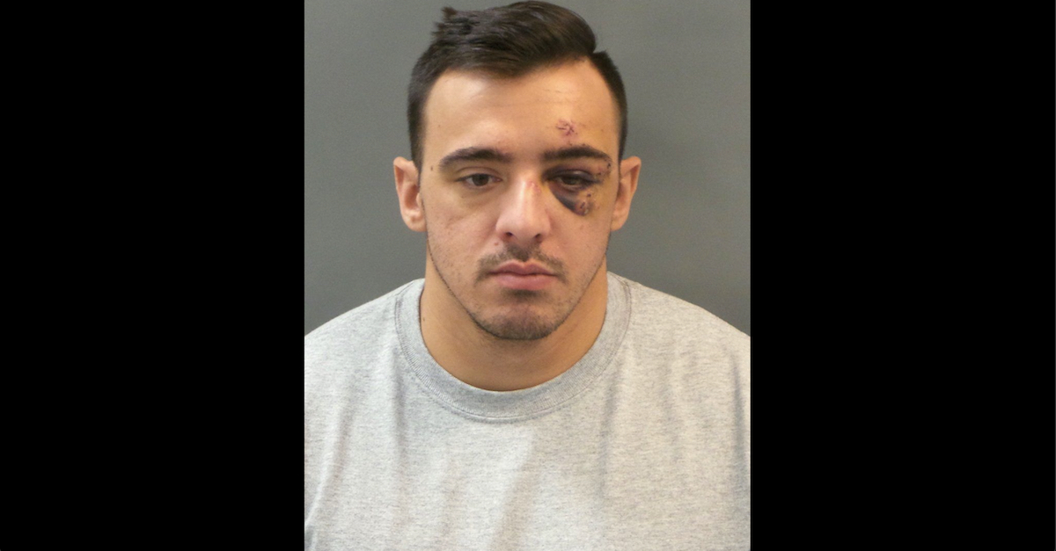
For instance…
INFORMATION
ASSUMPTION
CONCLUSION
He was hit by someone
People with black eyes have been hit
You see a man with a black eye

Slide 4
Information | Assumption | Conclusion
During class, a student asks “is this going to be on the test?” | This student is not interested in learning the subject | Students who ask questions like: “Is this going to be on the test?” are not interested in learning the subject
A police officer keeps trailing your car | He is trying to catch me breaking the law | Anytime a police officer trails you he is trying to catch you breaking the law
You see a child crying next to her mother in a grocery store | The mother has hurt the child | Whenever a child is crying next to her mother she has been hurt by her mother

Slide 5
Information
Your elder/younger sib is late coming home from a party
You see a well dressed stranger near a car late in the night
Your friend is talking to a member of the opposite sex at a birthday party
A toddler climbs into the waste basket

Slide 6
Rebus puzzle
AGE AGE AGE
DECI SION
ED
Middle Age
Half-hearted
Split decision
CHIEDITOREF
PHROMATE
talk
Editor-in-chief
Mixed metaphor
Small talk

Slide 7
Rebus puzzle
SECRET
SECRET
SECRET
and better
and better
S H O W
Slide show
Top secret
Bigger and better
T 2222
& GO
O-ER-T-O-
G E T
Tea for two
Get up and go!
Operation without Pain

Slide 8
That’s all for today
See you in the next session!!!

